Slide 1

Social Media Presentation on
Stumbleupon
A brief presentation on how power of IR changed the World of People
Made by:
Aman Bhargava - 16ucs027
Harshil Jain-16ucs074
Saloni Garg - 16ucs166
Jainish Shah - 16ucs172
Yatharth Shah - 16ucs222

Slide 2
What Is Stumbleupon :-
StumbleUpon was a discovery and advertisement engine that pushed recommends of web content to its users.
Its features allowed users to discover and rate Web pages, photos and videos that are personalized to their tastes and interests using peer-sourcing, social-networking and advertising principles.
Stumbleupon has now moved to Mix. It happened on Aug 1, 2017. It’s owner is Garrett Camp

Slide 3


How it is better than T.V or other media
StumbleUpon is for those times you just want the Internet to show you things. You don’t want to search, you don’t want to browse, you just want wonderful things to appear. Or maybe you feel like you’re in a rut, just hitting the same old sites over and over. If you can manage to type in “stumbleupon.com” and hit Enter, you’ve already accomplished the hard part.
Or, if you’re really chilled out and not even at your desktop, you can use StumbleUpon’s mobile apps for iPhone, iPad, Android, Nook and Kindle Fire. Once you have an account, StumbleUpon can bring delightful things to whatever device you’re using.

Slide 4
Areas of Implementation of Information Retrieval in Stumbleupon
Recommending Blogs and Bloggers:- Collaborative filtering
Search :-
Simple Search by Tags
Opinion Search
Notes:
First, i have no inside knowledge of S/U's Recommendation Engine. What i do know, i've learned from following this topic for the last few years and from studying the publicly available sources (including StumbleUpon's own posts on their company Site and on their Blog), and of course, as a user of StumbleUpon.
I haven't found a single source, authoritative or otherwise, that comes anywhere close to saying "here's how the S/U Recommendation Engine works", still given that this is arguably the most successful Recommendation Engine ever--the statistics are insane, S/U accounts for over half of all referrals on the Internet, and substantially more than facebook, despite having a fraction of the registered users that facebook has (800 million versus 15 million); what's more S/U is not really a site with a Recommendation Engine, like say, Amazon.com, instead the Site itself is a Recommendation Engine--there is a substantial volume of discussion and gossip among the fairly small group of people who build Recommendation Engines such that if you sift through this, i think it's possible to reliably discren the types of algorithms used, the data sources supplied to them, and how these are connected in a working data flow.
The description below refers to my Diagram at bottom. Each step in the data flow is indicated by a roman numeral. My description proceeds backwards--beginning with the point at which the URL is delivered to the user, hence in actual use step I occurs last, and step V, first.
salmon-colored ovals => data sources
light blue rectangles => predictive algorithms
I. A Web Page recommended to an S/U user is the last step in a multi-step flow
II. The StumbleUpon Recommendation Engine is supplied with data (web pages) from three distinct sources:
web pages tagged with topic tags matching your pre-determined Interests (topics a user has indicated as interests, and which are available to view/revise by clicking the "Settings" Tab on the upper right-hand corner of the logged-in user page);
socially Endorsed Pages (*pages liked by this user's Friends*); and
peer-Endorsed Pages (*pages liked by similar users*);
III. Those sources in turn are results returned by StumbleUpon predictive algorithms (Similar Users refers to users in the same cluster as determined by a Clustering Algorithm, which is perhaps k-means).
IV. The data used fed to the Clustering Engine to train it, is comprised of web pages annotated with user ratings
V. This data set (web pages rated by StumbleUpon users) is also used to train a Supervised Classifier (e.g., multi-layer perceptron, support-vector machine) The output of this supervised classifier is a class label applied to a web page not yet rated by a user.
The single best source i have found which discussed SU's Recommendation Engine in the context of other Recommender Systems is this BetaBeat Post.

Slide 5
Simple Search
When a User enters a query in the search bar , platform searches for only those posts which contain that query as it’s tag.
Ex:- #Dance , #Food
This approach was used at the time of inception of StumbleUpon .

Slide 6
Opinion Search
It is used when search needs to be done considering the context of the user query to enhance search results.
Opinion search falls in the border area of Sentimental Analysis.
Ex:- “Find me blog posts with benefits of dieting”.

Slide 7
Lexicon Based approach For Opinion Search :-
Lexicon-based approaches build a list of terms with known semantic orientation, the so-called opinionated lexicon or dictionary.
Such approaches search for opinionated blog posts by quantifying the occurrence of lexicon terms in each post.

Slide 8
Static Lexicons :-
Static Sentiment lexicons are sets of words and phrases that are associated with predefined numeric scores, which show the sentiment and/or emotional orientation of the words.
In some lexicons, these words are simply labelled as positive or negative.
The granularity of scores is higher in some lexicons, in which the assigned scores range from −5 to + 5.

Slide 9
Limitations of Static Lexicons :-
Creation of manual lexicons is hard
These lexicons are static which make them less suitable to be applied in polarity detection on Post , due to challenges of sentiment analysis on StumbleUpon data. For ex:-
Challenges include prevalent misspellings and slangs which develops StumbleUpon own culture and language , wide range of topics covered by StumbleUpon users (unlike in the case of news and online journals), and short length of query which limits their sentiment cues.
.

Slide 10
Dynamic Lexicon
Adaptive lexicon learning by genetic algorithm (ALGA)
In this method, a sentiment lexicon is generated for the datasets in the training phase, and this lexicon is used for classification of tweets in the test phase.
This lexicon contains sentiment words with a score assigned to them.
This score is calculated and is in the range of the lowest and highest score a sentiment word can have.(Here -10 to +10)
Notes:
Ye likh ese heading

Slide 11

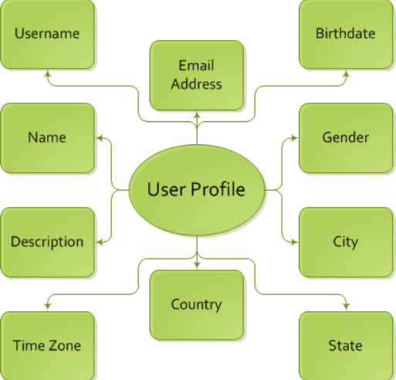
Working of Stumbleupon
A look at how S/U provides it’s recommendations

Slide 12
Ranking of Content of Particular Topic
The key with StumbleUpon is sharing websites, utilizing the thumbs up and thumbs down options and writing reviews and/or adding comments to sites.

Slide 13
How Algorithm in Stumbleupon works
Rating Web sites update a personal profile (a blog-style record of rated sites) and generate peer networks of Web surfers linked by common interest.
Giving a site a thumbs up results in the site being placed under the user’s “favourites”. Furthermore, users have the ability to stumble their personal interests like “History” or “Games”.
These social networks coordinate the distribution of Web content, so that users “stumble upon” pages explicitly recommended by friends and peers.

Slide 14
Other Exclusive content filtering features
Users rate a site by giving it a thumbs up, thumbs down selection on the StumbleUpon toolbar, and can optionally leave additional commentary on the site’s review page, which also appears on the user’s blog.
This social content discovery approach automates the “word-of-mouth” referral of peer-approved Web sites and simplifies Web navigation.
In the settings section of Stumbleupon you can further filter the types of web pages you may come across. There are interest filters which allow you to include only content for all ages, R rated content, or X rated content

Slide 15
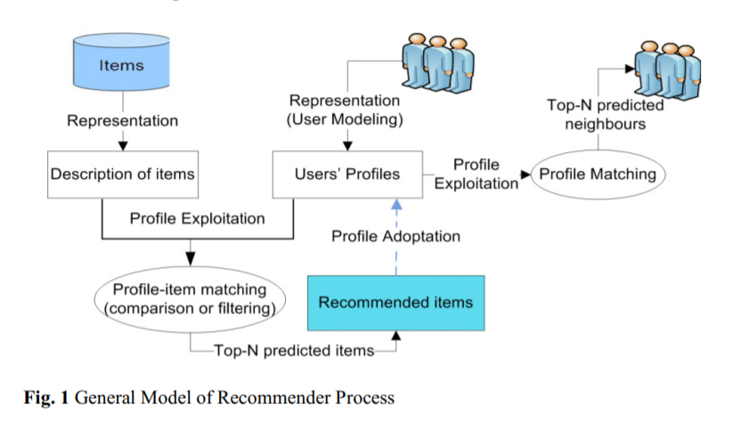
Recommender system challenges in Stumbleupon
A recommender system is an Information Retrieval technology that improves access and proactively recommends relevant items to users by considering the users’ explicitly mentioned preferences and objective behaviours.

Slide 16
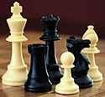
Shilling Attack
if a malicious user or competitor enters into a system and starts giving false ratings on some items either to increase the item popularity or to decrease its popularity.

Slide 17
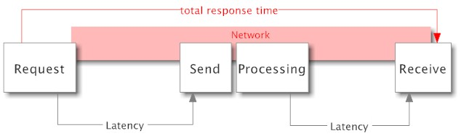
Latency Problem
Recommenders face latency problem when new items are added more frequently to the database, where the recommender suggests only the already rated items as the newly added items are not yet rated.

Slide 18
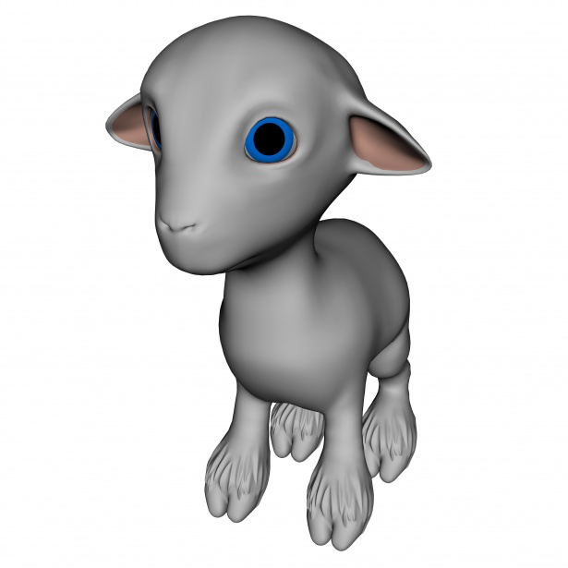
Grey Sheep
Recommenders face latency problem when new items are added more frequently to the database, where the recommender suggests only the already rated items as the newly added items are not yet rated

Slide 19

Privacy
Feeding personal information to the recommender systems results in better recommendation services but may lead to issues of data privacy and security. Users are reluctant to feed data into recommender systems that suffer from data privacy issues

Slide 20
Collaborative filtering
StumbleUpon uses collaborative filtering (an automated process combining human opinions with machine learning of personal preference) to create virtual communities of like-minded Web surfers.

Slide 21
What is Collaborative Filtering?
Collaborative filtering is the process of filtering for information or patterns using techniques involving collaboration among multiple agents, viewpoints, data sources, etc. It is a method of making automatic predictions (filtering) about the interests of a user by collecting preferences or taste information from many users.
The underlying assumption of the collaborative filtering approach is that if a person A has the same opinion as a person B on an issue, A is more likely to have B's opinion on a different issue than that of a randomly chosen person

Slide 22
3. Workflow of a collaborative filtering system is:-
A user expresses his or her preferences by rating items of the system. These ratings can be viewed as an approximate representation of the user's interest in the corresponding domain.
The system matches this user's ratings against other users' and finds the people with most "similar" tastes.
With similar users, the system recommends items that the similar users have rated highly but not yet being rated by this user.
2 main types of CF are :
(a) Memory Based Model :
Examples of this approach are neighbourhood-based CF and item-based/user-based top-N recommendation
Similarity computation between items or users is calculated using Multiple measures, such as pearson correlation and cosine similarity based similarity..

Slide 23
The k most similar users to an active user are found then their corresponding user-item matrices are aggregated to identify the set of items to be recommended. Example Nearest Neighbourhood method
(b) Model Based Model
Many model-based CF algorithms like Bayesian networks, clustering models, latent semantic models such as singular value decomposition, probabilistic latent semantic analysis, multiple multiplicative factor, latent Dirichlet allocation and Markov decision process based models
In this approach, dimensionality reduction methods are mostly being used as complementary technique to improve robustness and accuracy of memory-based approach. In this sense, methods like singular value decomposition, principle component analysis, known as latent factor models, compress user-item matrix into a low-dimensional representation in terms of latent factors

Slide 24
StumbleUpon Working
StumbleUpon works as a “Single Action Personalized Recommendation” system.
Client system sends to the server system the client identifier,the URL referencing the currently displayed content and the indicated rating just by mouse clicking.
Server systems incorporate into their recommendation calculations user-specific information such as user preferences, demographic data, content rating history, and content-specific information Such as Subject matter,content quality,complexity of language, and general aesthetics.
The database of content from which recommendations are chosen is itself built from content recommended to the system by users.Once the content to recommend has been chosen, the server system determines the URL(s) which refer to that Recommended Content. The server instructs the browser to retrieve and display the content recommended by the server system, referenced by the URL.

Slide 25
Recommended content is associated with indexing information, the form of which may be dictated by the personalization Software or Supporting applications.The server stores the recommendation in the Recommended Content Data Database. The server also stores the rating in the Rating Database.
Given System, has a dual-recommendation nature whereby users recommend content to the server system, and the server system, through personalization calculations, recommends that same.
Concrete information on how StumbleUpon’s collaborative filtering system actually works is scarce (and probably proprietary). However, the user Doug on this StackOverflow page provides a helpful theory

Slide 26
In Doug’s diagram below, pink ovals are data sources, and blue rectangles are predictive algorithms.
StumbleUpon has three sources of data: (1) pages tagged with user-selected interests, (2) pages liked by friends, and (3) pages like by similar users.
User ratings in the form of page likes and dislikes train a supervised classifier model that categorizes pages by topic.
User ratings also train an unsupervised clustering model, which groups users by similarity of likes and dislikes.
These two algorithms, along with pages liked by the user’s friends, create sources of data that feed into a recommendation engine, which then provides users with content.

Slide 27
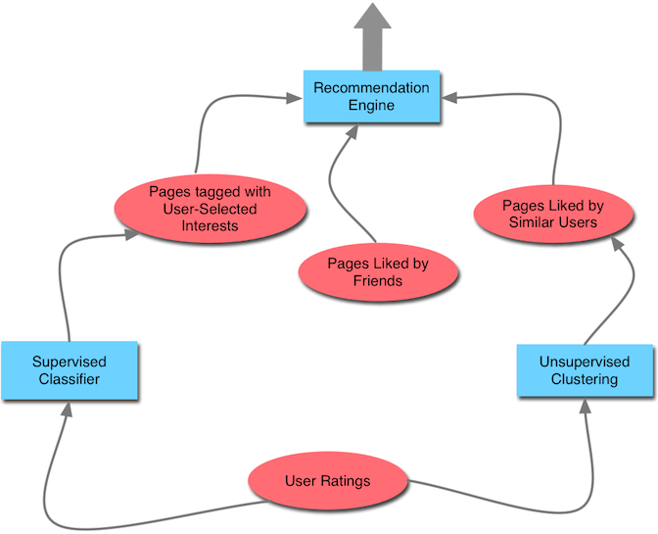

Slide 28
Illustration of Collaborative Filtering
This image shows an example of predicting of the user's rating using collaborative filtering. At first, people rate different items (like videos, images, games). After that, the system is making predictions about user's rating for an item, which the user hasn't rated yet. These predictions are built upon the existing ratings of other users, who have similar ratings with the active user. For instance, in our case the system has made a prediction, that the active user won't like the video.

Slide 29
Problem of Automated Collaborative Filtering
In general, collaborative filtering has to cope with the possibility of manipulation. Another drawback is that a critical mass of ratings and users is required to receive useful recommendations.
Since all current search engines and concepts for research paper recommender systems focus mainly on one approach (text analysis, citation analysis or ratings), each concept suffers the disadvantages mentioned above.

Slide 30
Problem of Automated Collaborative Filtering
The problem of automated collaborative filtering is to predict how well a user will like an item that he/she has not rated.
Collaborative filtering in the domain of research paper recommendation is criticised for various reasons. Some authors claim that collaborative filtering would be ineffective in domains where more items than users exist. Others believe that users would be unwilling to spend time for explicitly rating the content.

Slide 31
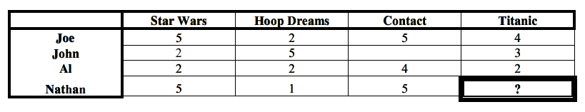
Neighbourhood algorithms of Collaborative Filtering Methods
We want to predict Nathan’s rating for ‘Titanic’
Joe is Nathan’s best neighbour here

Slide 32
Neighbourhood algorithms of Collaborative Filtering Methods
We can look at some of the neighbourhood based collaborative filtering methods and look at their advantages and disadvantages
> Weight the users with respect to similarity with active user.
> Select a subset of users to use as a set of predictors (possibly for a specific item)
> Normalise ratings and compute prediction from a weighted combination of selected neighbours ratings.

Slide 33
Bibliography
https://patentimages.storage.googleapis.com/cf/c3/3e/f21f050c1e745e/US8078615.pdf

